Slide 1
Tectonic Geomorphology 2nd Edition Burbank and Anderson
Chapter 9: Deformation and geomorphology at intermediate time scales
Figures, Boxes, Plates, Tables

Slide 2
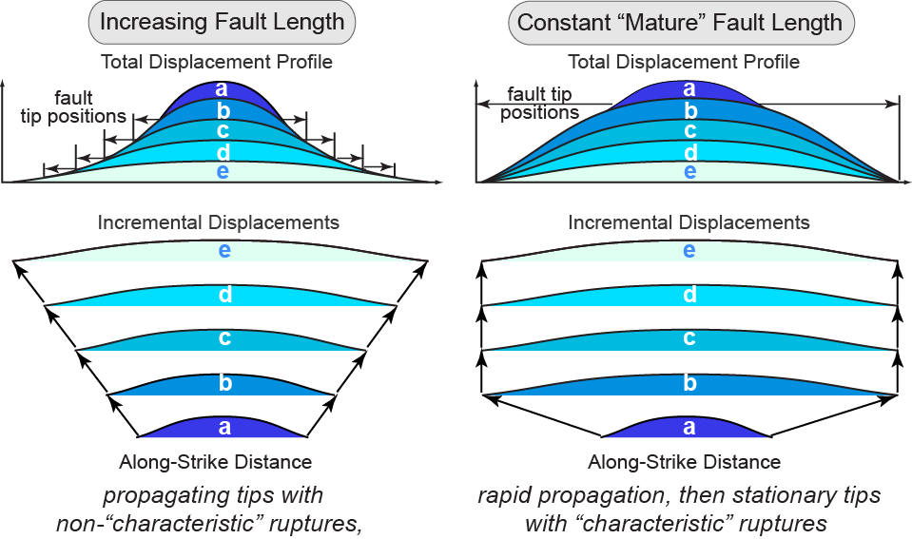
Burbank and Anderson, 2011, Tectonic Geomorphology, Chapter 9

Slide 3
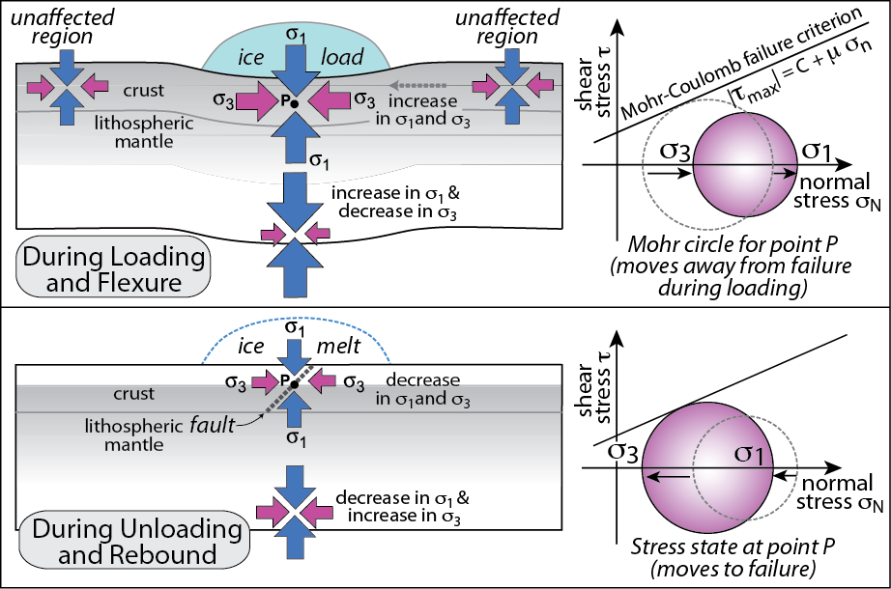
Burbank and Anderson, 2011, Tectonic Geomorphology, Chapter 9

Slide 4
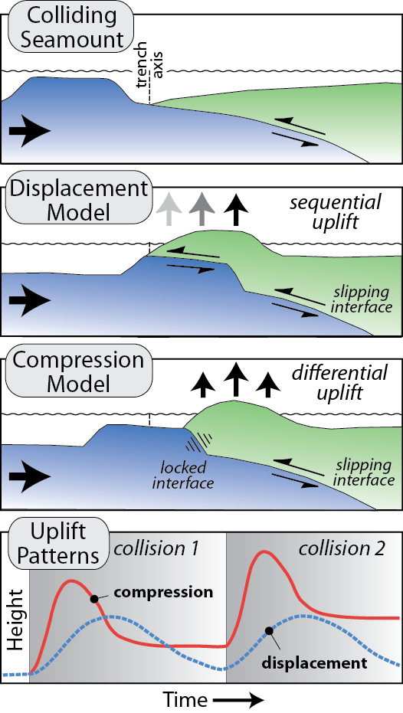
Burbank and Anderson, 2011, Tectonic Geomorphology, Chapter 9

Slide 5
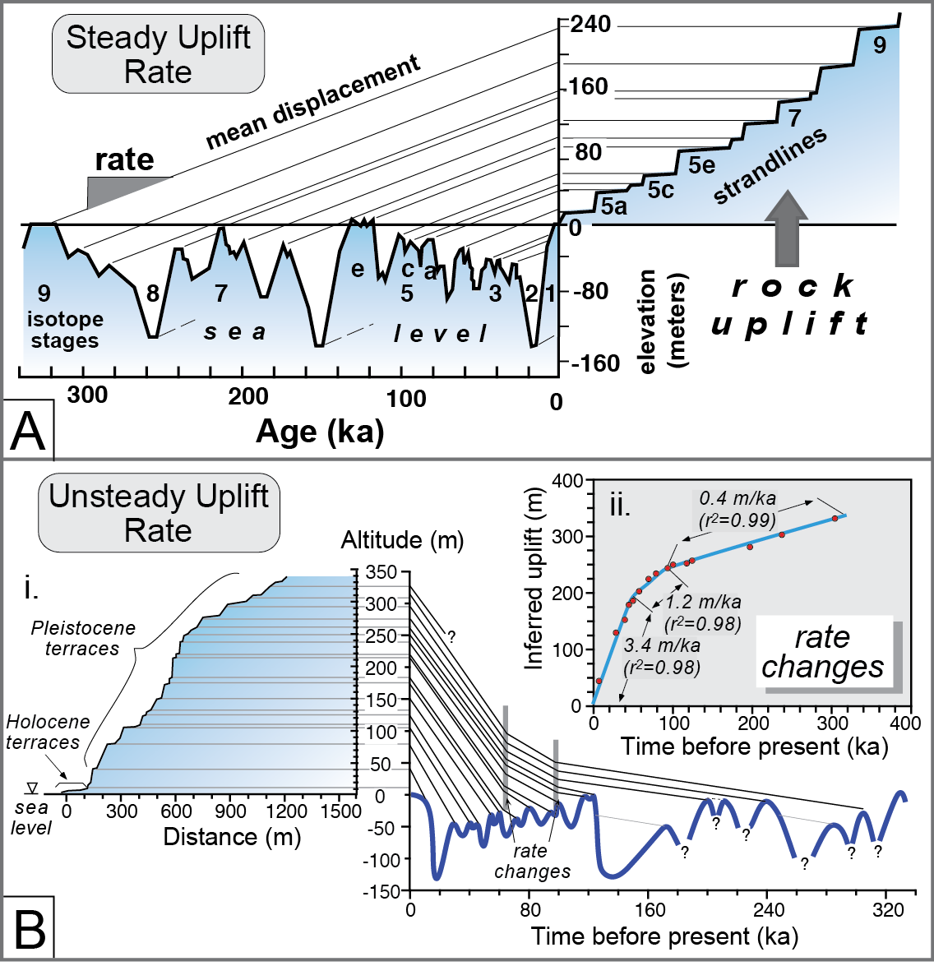
Burbank and Anderson, 2011, Tectonic Geomorphology, Chapter 9

Slide 6
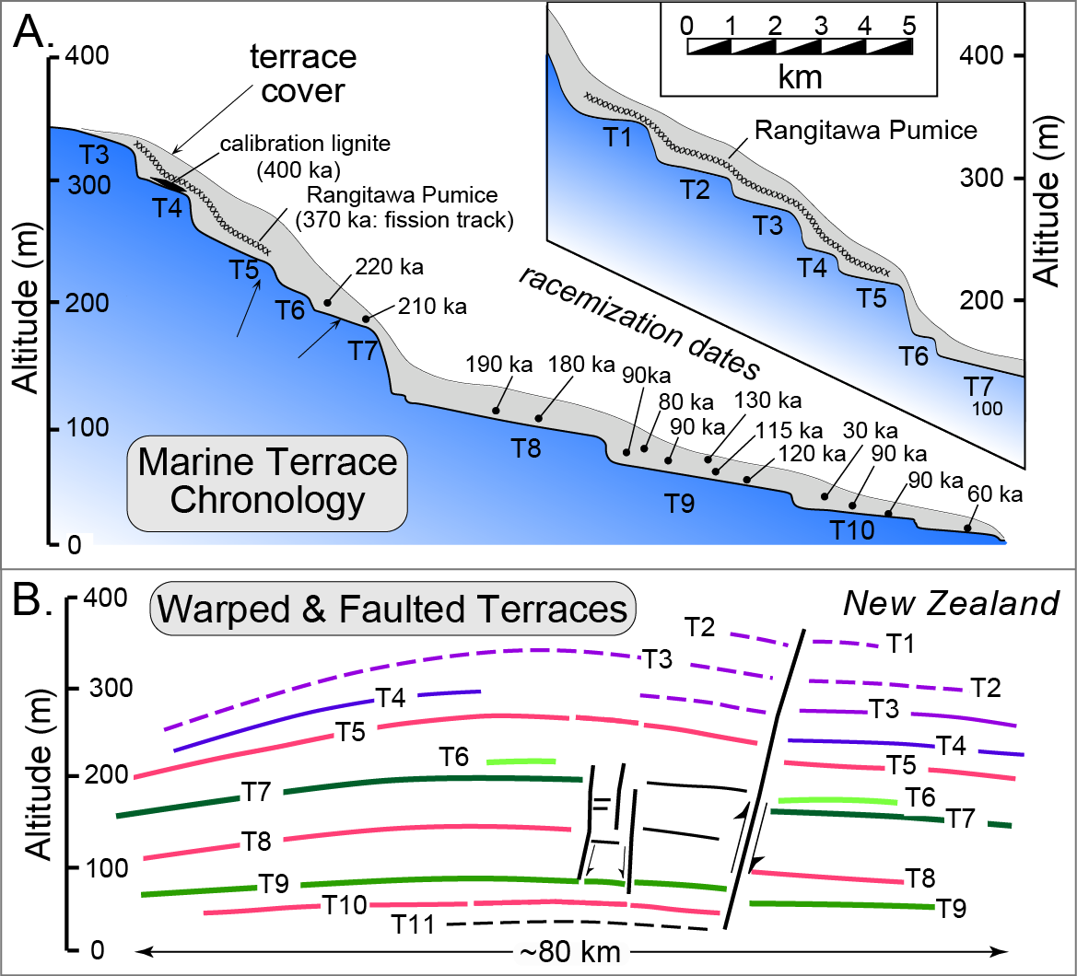
Burbank and Anderson, 2011, Tectonic Geomorphology, Chapter 9

Slide 7
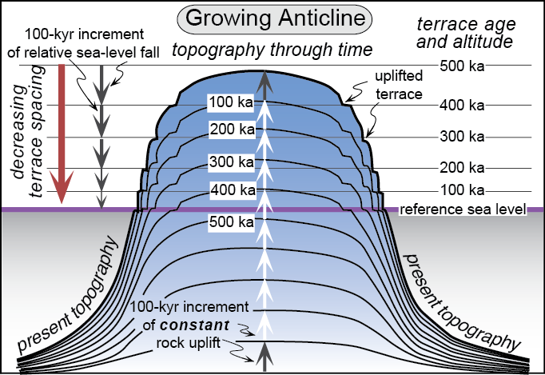
Burbank and Anderson, 2011, Tectonic Geomorphology, Chapter 9

Slide 8
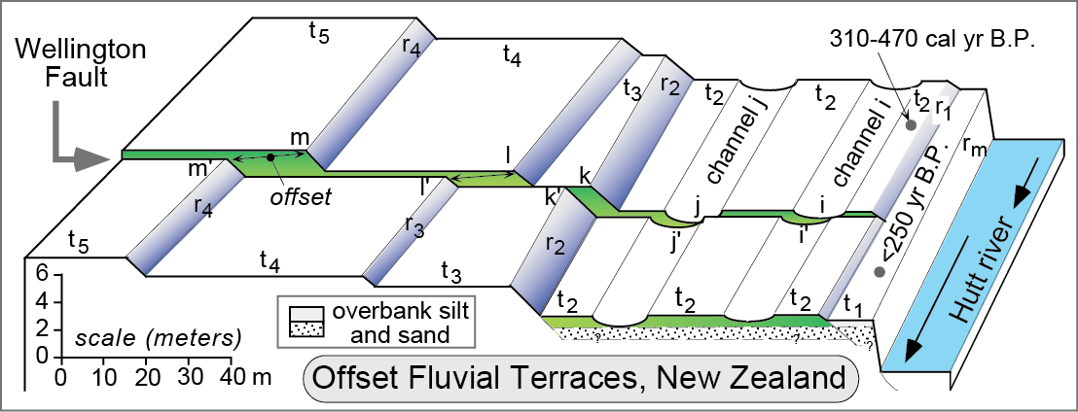
Burbank and Anderson, 2011, Tectonic Geomorphology, Chapter 9

Slide 9
Burbank and Anderson, 2011, Tectonic Geomorphology, Chapter 9

Slide 10
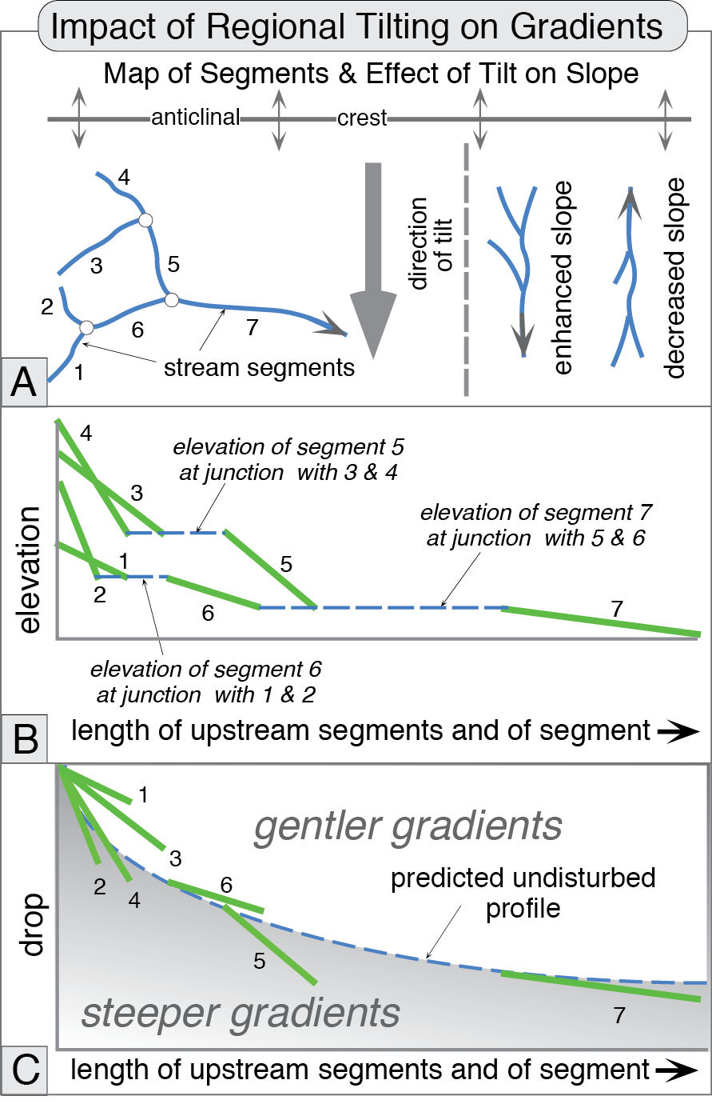
Burbank and Anderson, 2011, Tectonic Geomorphology, Chapter 9

Slide 11
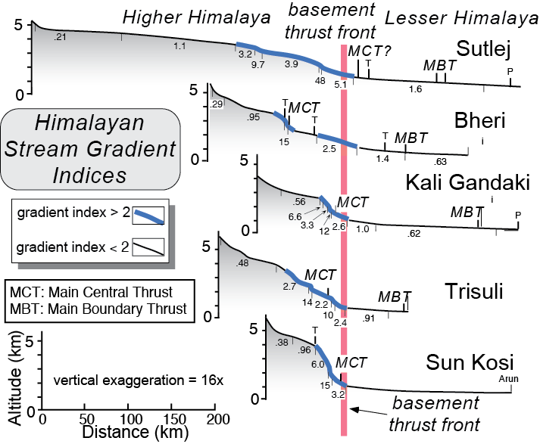
Burbank and Anderson, 2011, Tectonic Geomorphology, Chapter 9

Slide 12
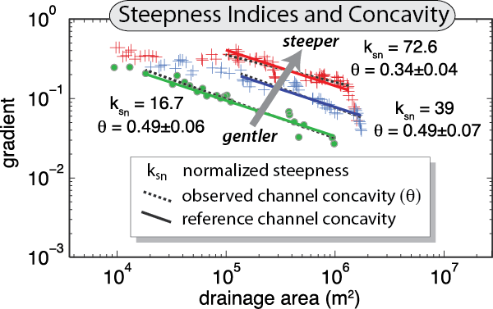
Burbank and Anderson, 2011, Tectonic Geomorphology, Chapter 9

Slide 13
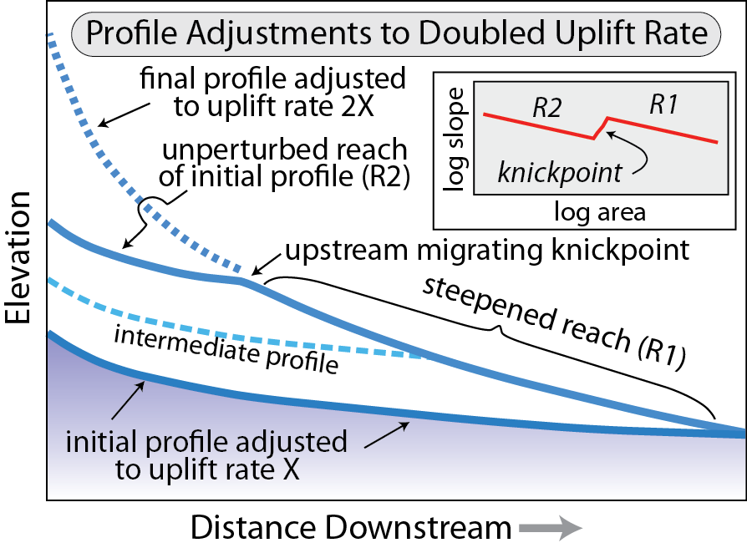
Burbank and Anderson, 2011, Tectonic Geomorphology, Chapter 9

Slide 14
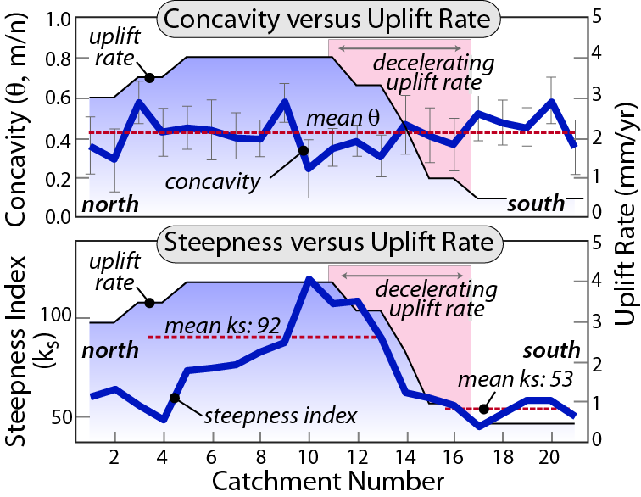
Burbank and Anderson, 2011, Tectonic Geomorphology, Chapter 9

Slide 15
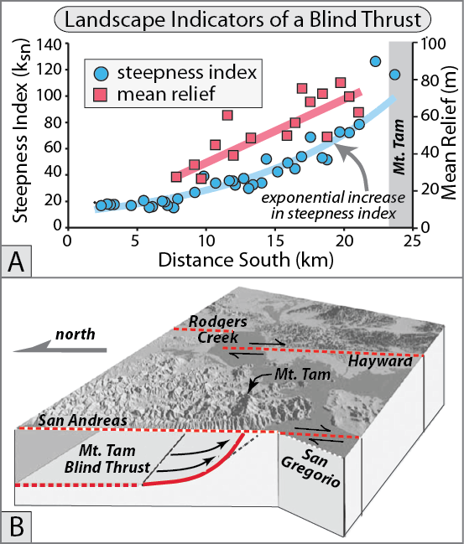
Burbank and Anderson, 2011, Tectonic Geomorphology, Chapter 9

Slide 16
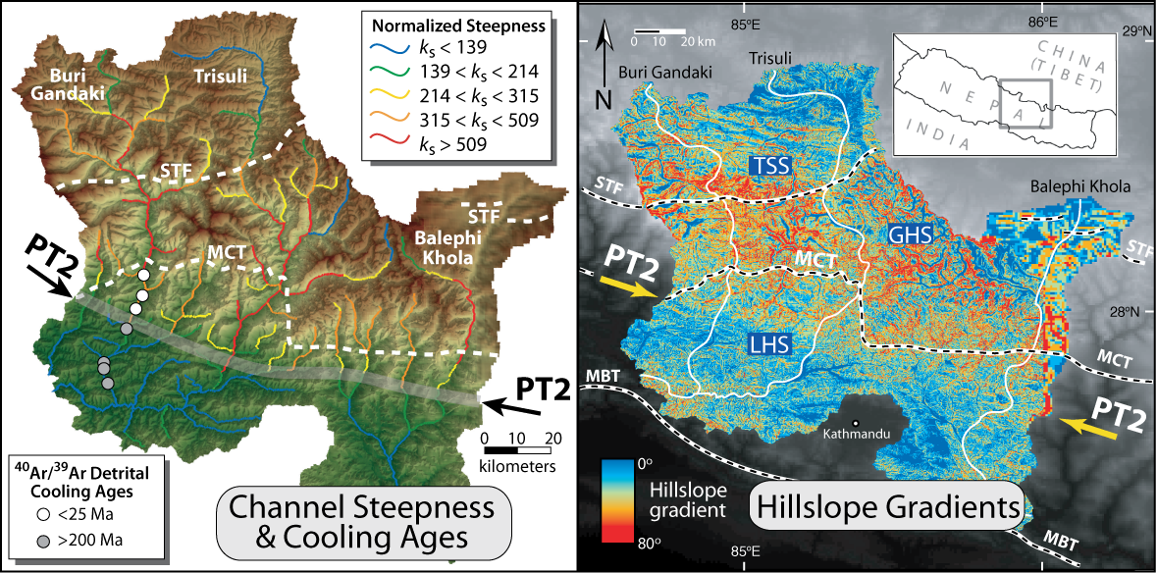
Burbank and Anderson, 2011, Tectonic Geomorphology, Chapter 9

Slide 17
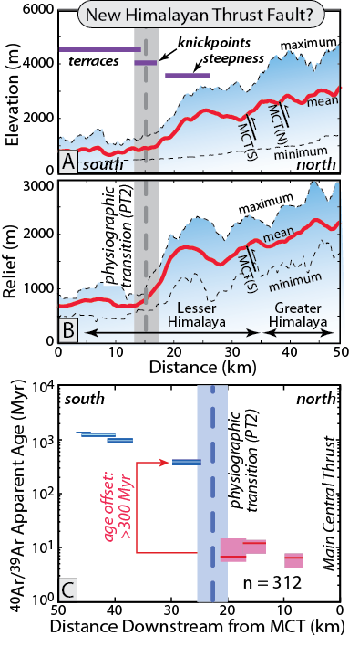
Burbank and Anderson, 2011, Tectonic Geomorphology, Chapter 9

Slide 18
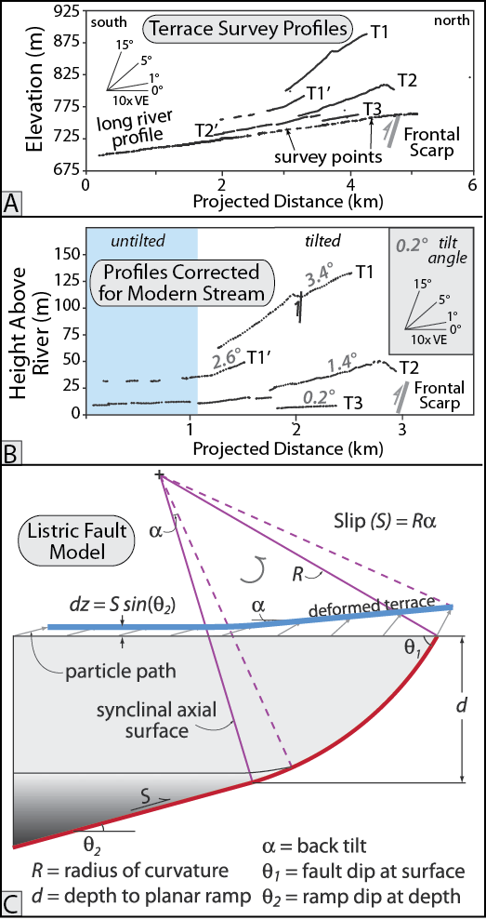
Burbank and Anderson, 2011, Tectonic Geomorphology, Chapter 9

Slide 19
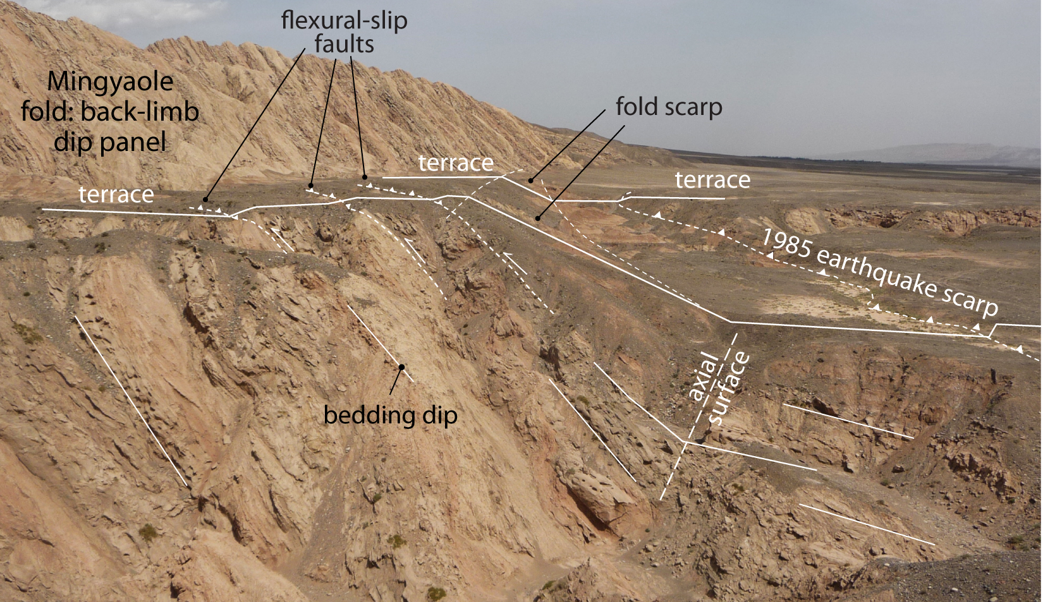
Burbank and Anderson, 2011, Tectonic Geomorphology, Chapter 9

Slide 20
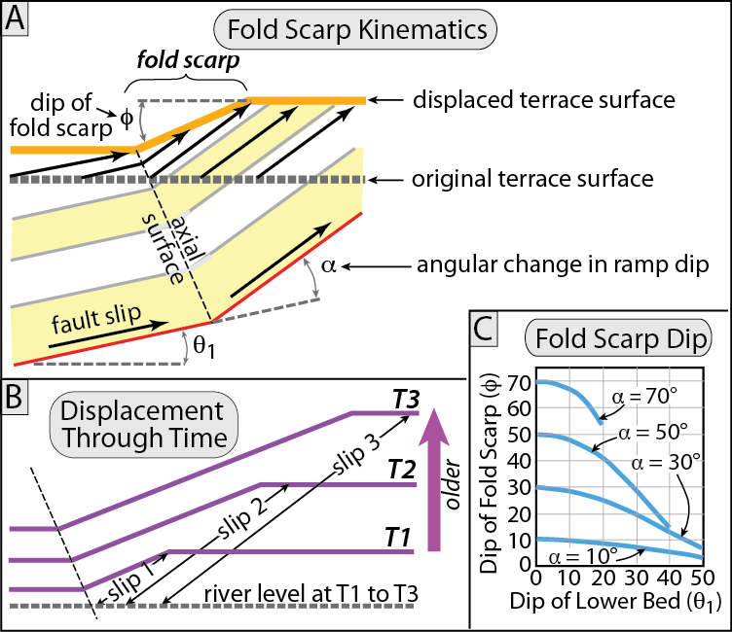
Burbank and Anderson, 2011, Tectonic Geomorphology, Chapter 9

Slide 21
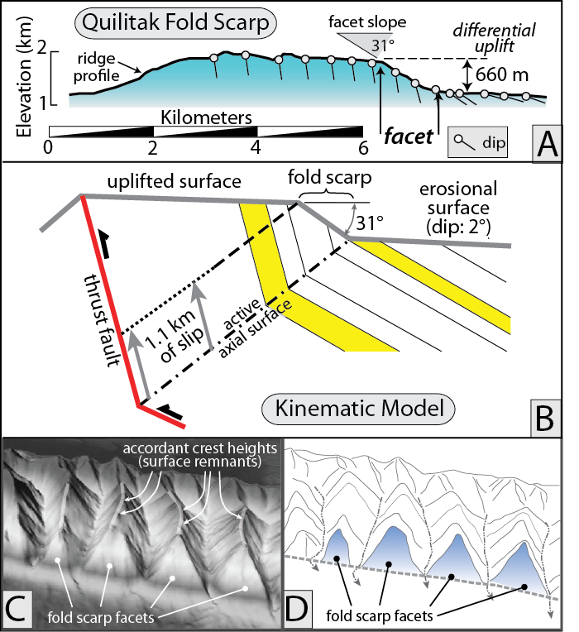
Burbank and Anderson, 2011, Tectonic Geomorphology, Chapter 9

Slide 22
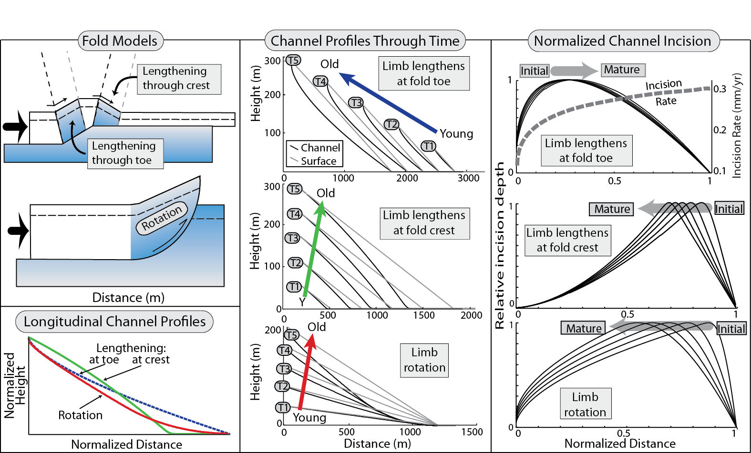
Burbank and Anderson, 2011, Tectonic Geomorphology, Chapter 9

Slide 23
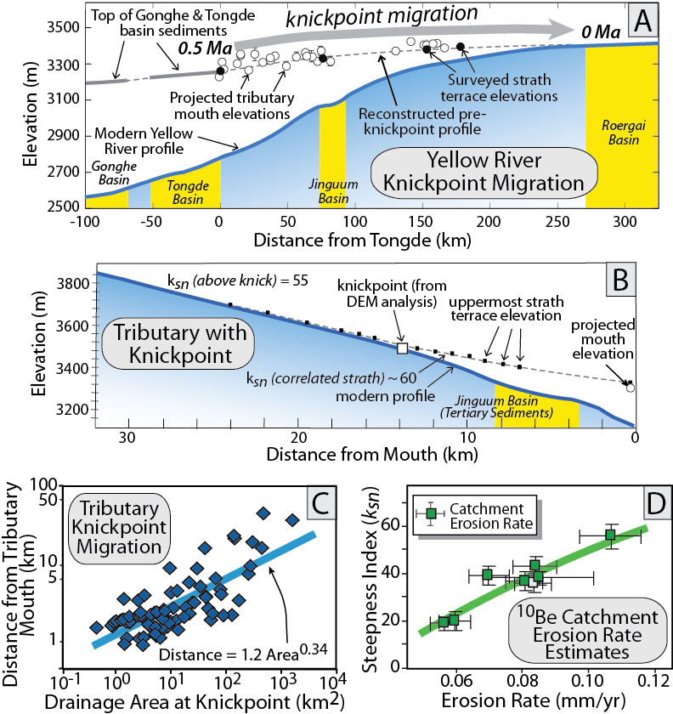
Burbank and Anderson, 2011, Tectonic Geomorphology, Chapter 9

Slide 24
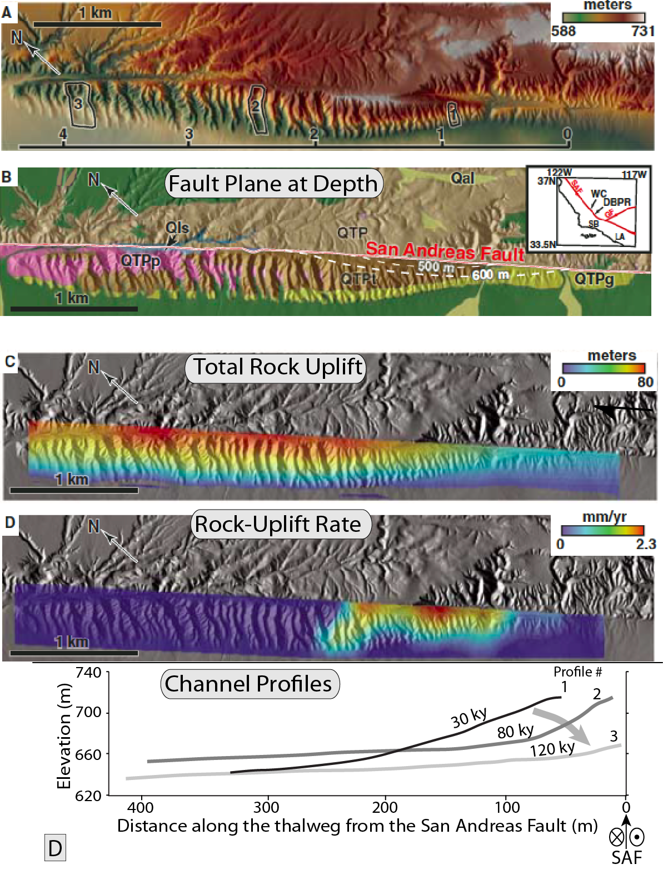
Burbank and Anderson, 2011, Tectonic Geomorphology, Chapter 9

Slide 25
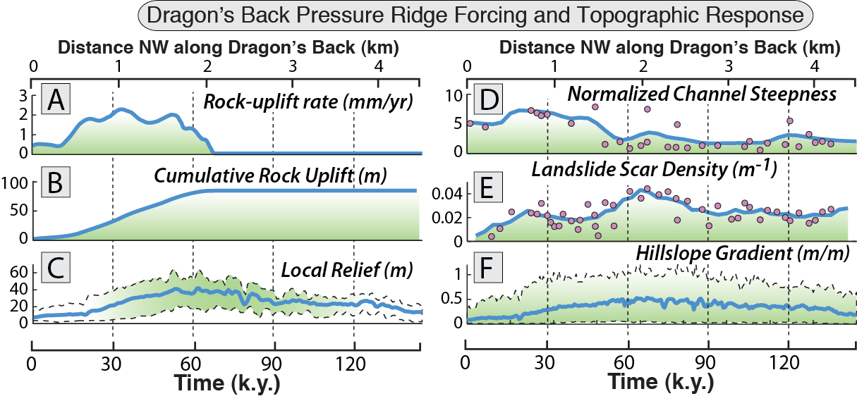
Burbank and Anderson, 2011, Tectonic Geomorphology, Chapter 9

Slide 26
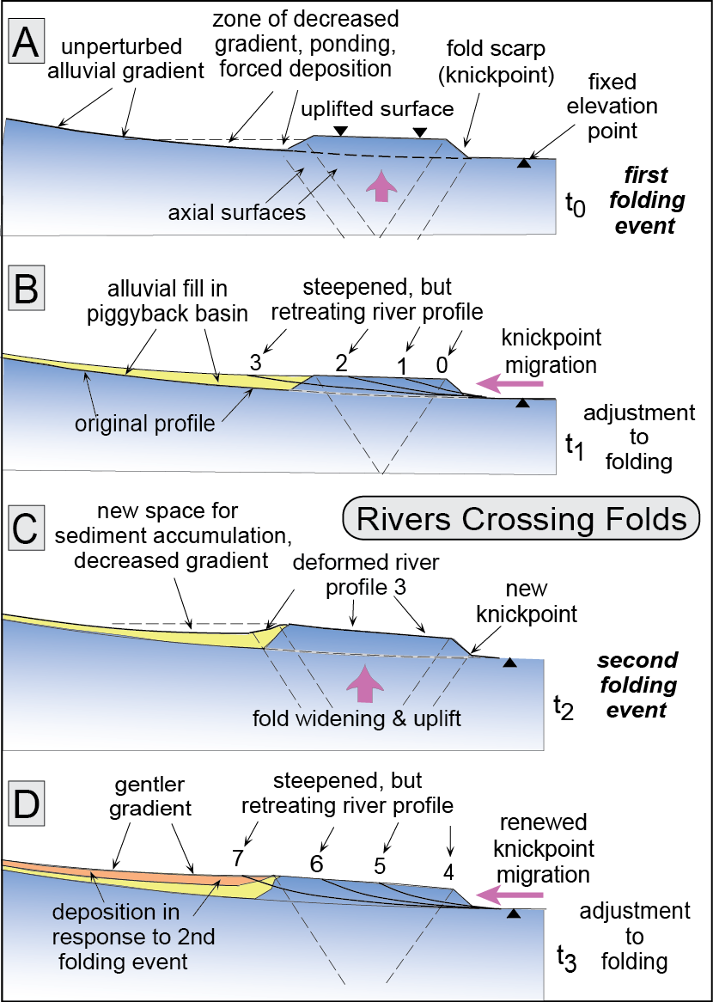
Burbank and Anderson, 2011, Tectonic Geomorphology, Chapter 9

Slide 27
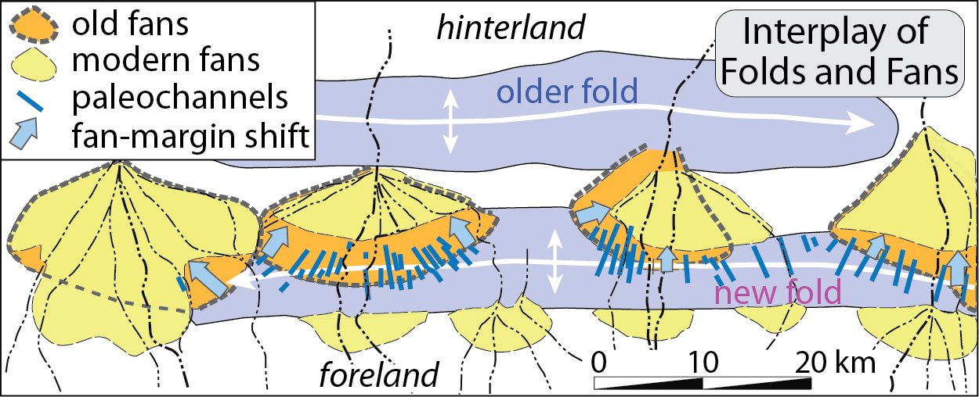
Burbank and Anderson, 2011, Tectonic Geomorphology, Chapter 9

Slide 28
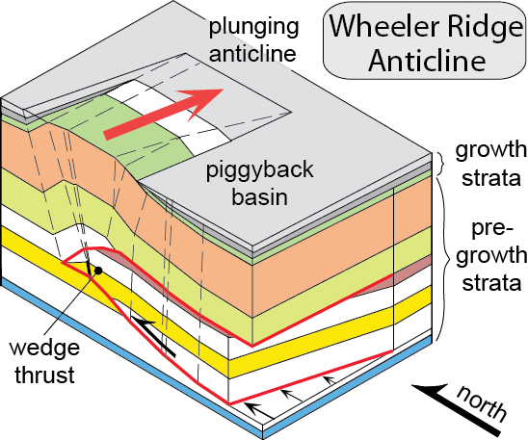
Burbank and Anderson, 2011, Tectonic Geomorphology, Chapter 9

Slide 29
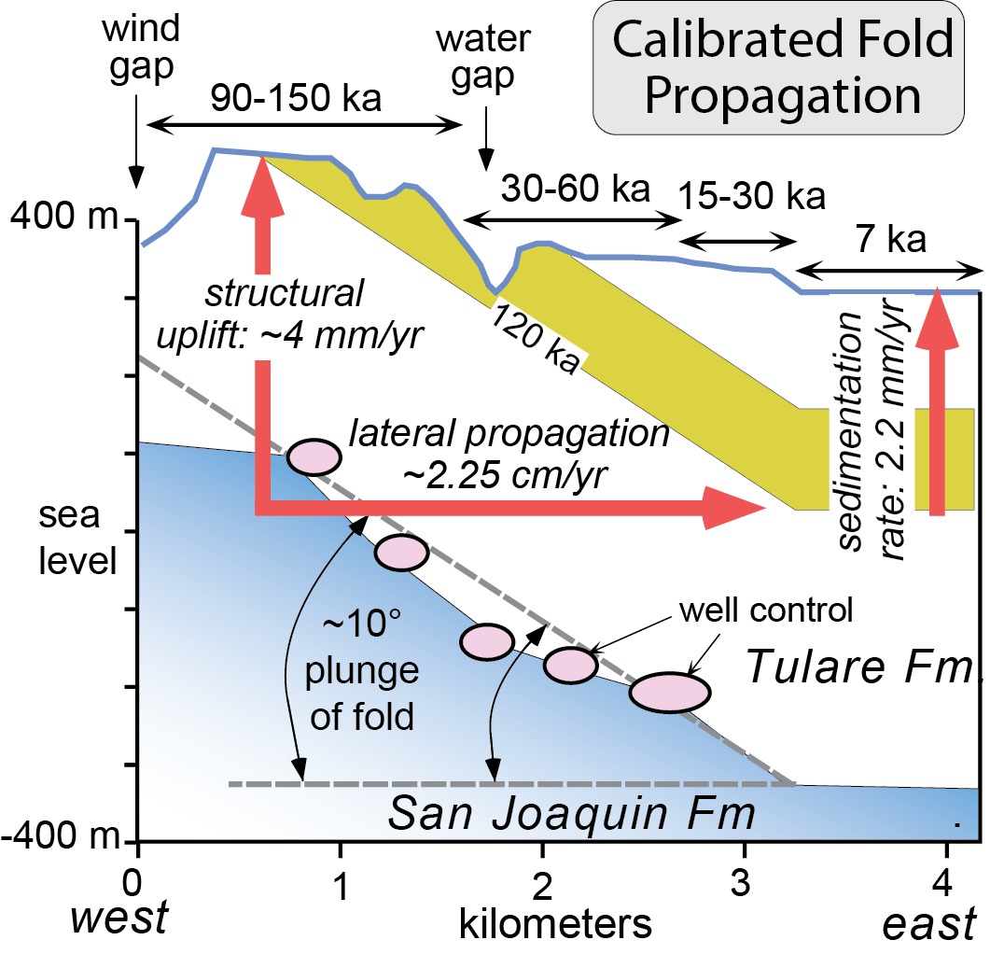
Burbank and Anderson, 2011, Tectonic Geomorphology, Chapter 9

Slide 30
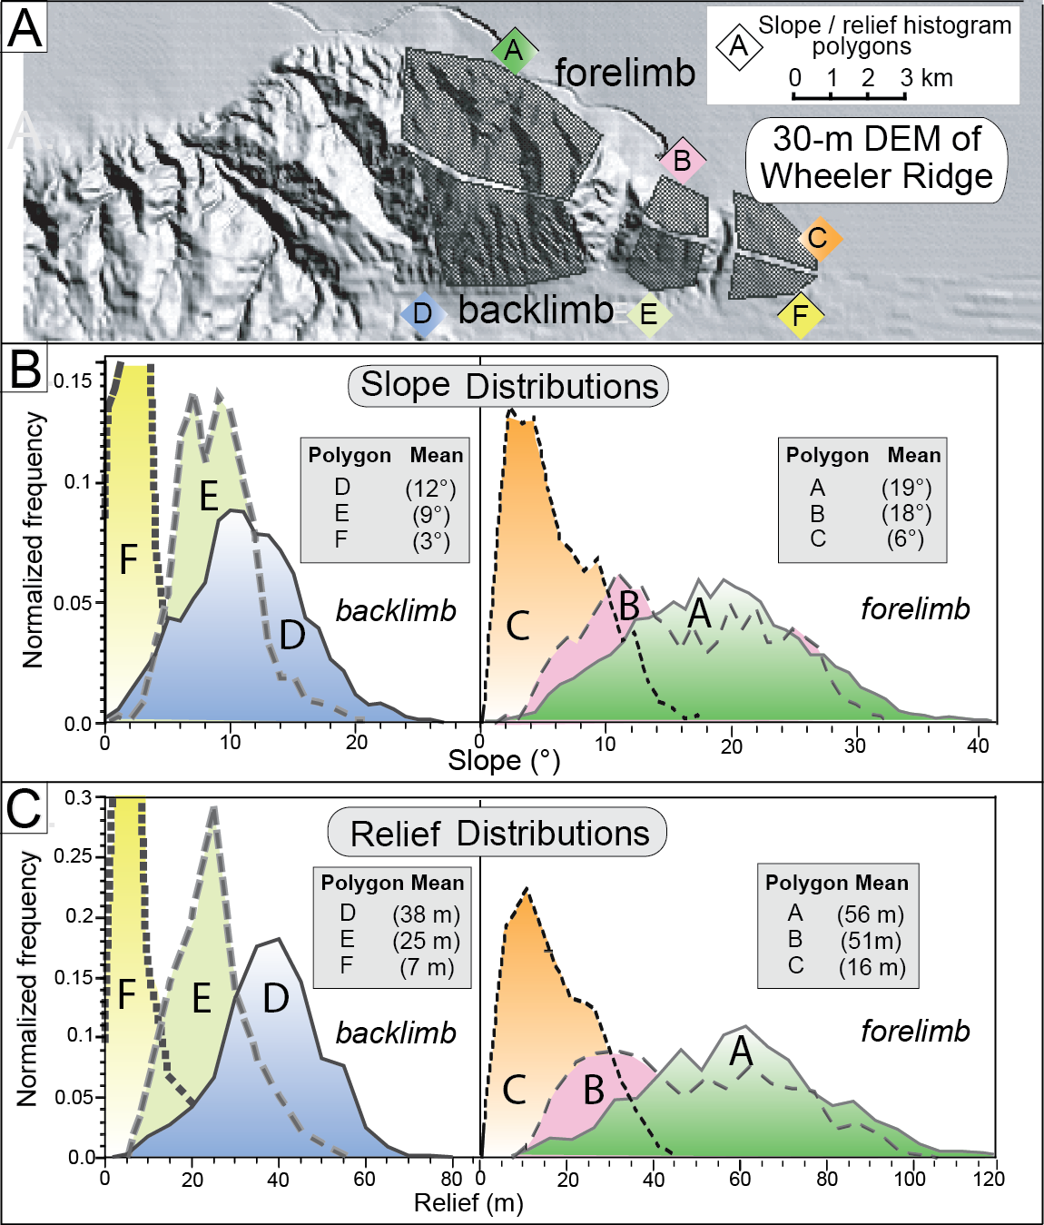
Burbank and Anderson, 2011, Tectonic Geomorphology, Chapter 9

Slide 31
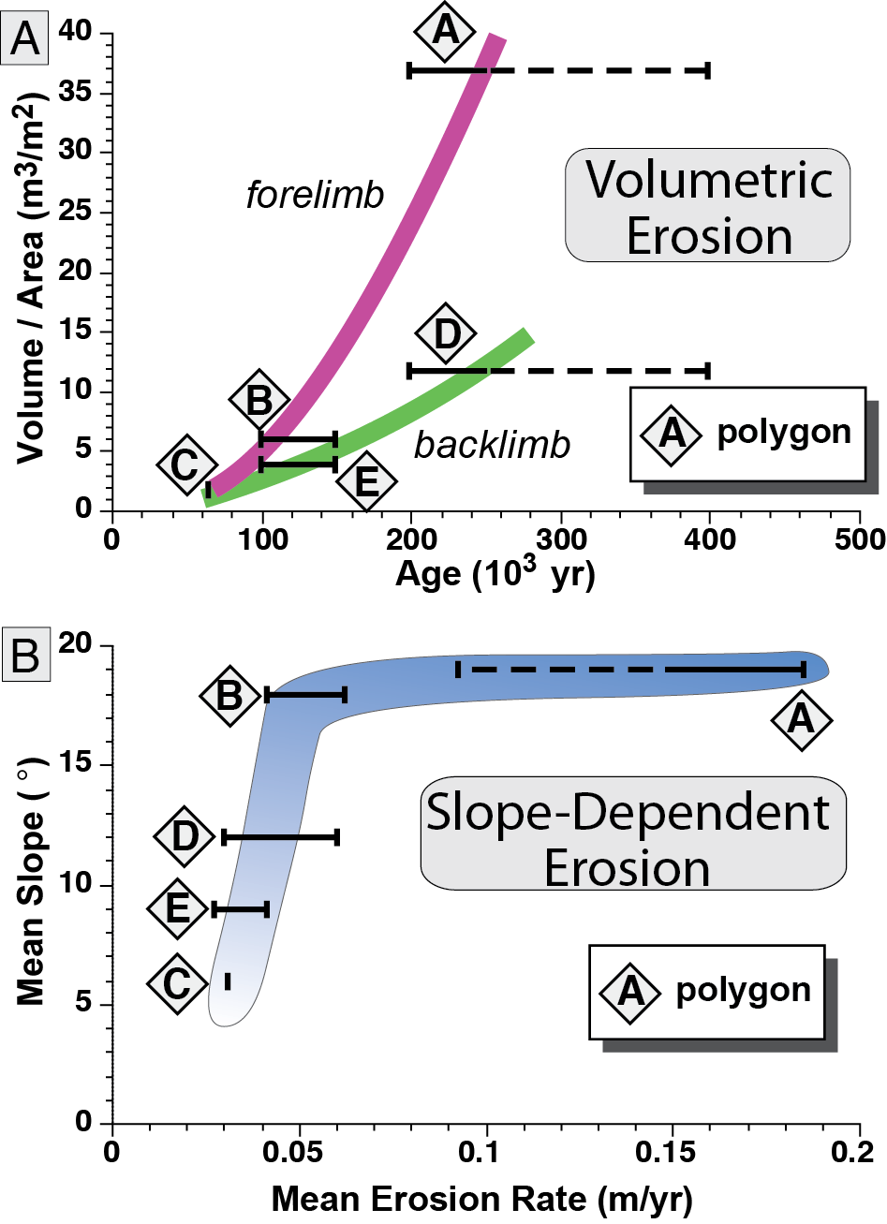
Burbank and Anderson, 2011, Tectonic Geomorphology, Chapter 9

Slide 32
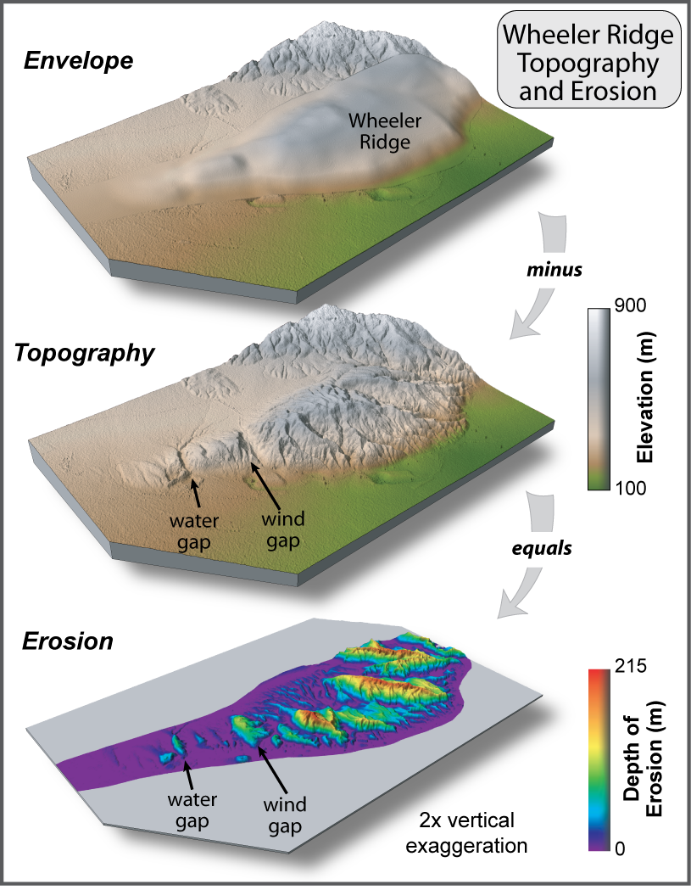
Burbank and Anderson, 2011, Tectonic Geomorphology, Chapter 9

Slide 33
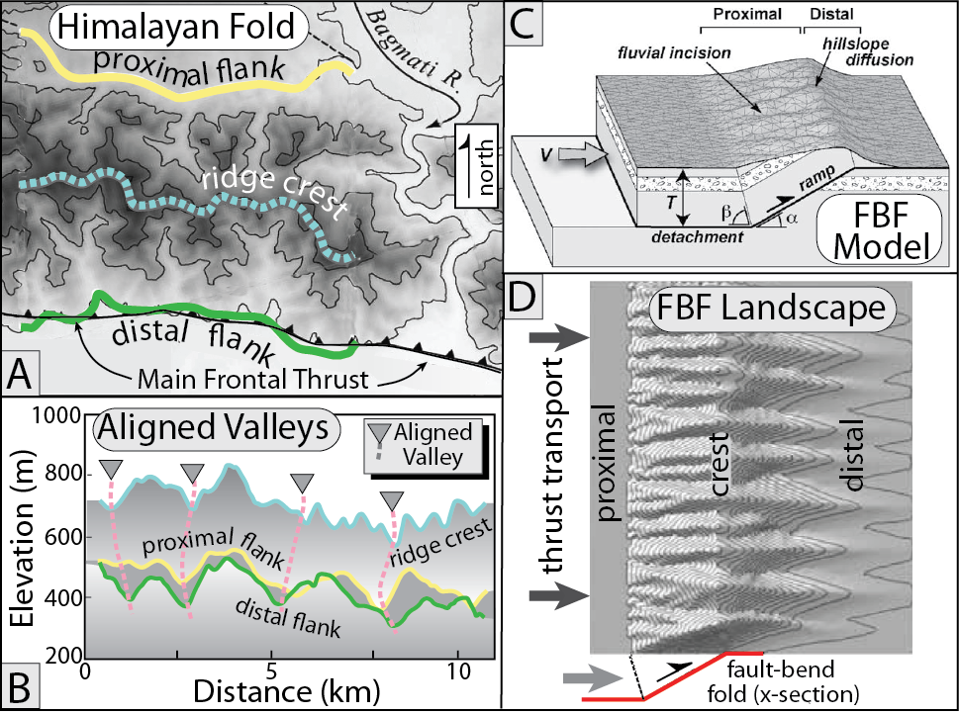
Burbank and Anderson, 2011, Tectonic Geomorphology, Chapter 9

Slide 34
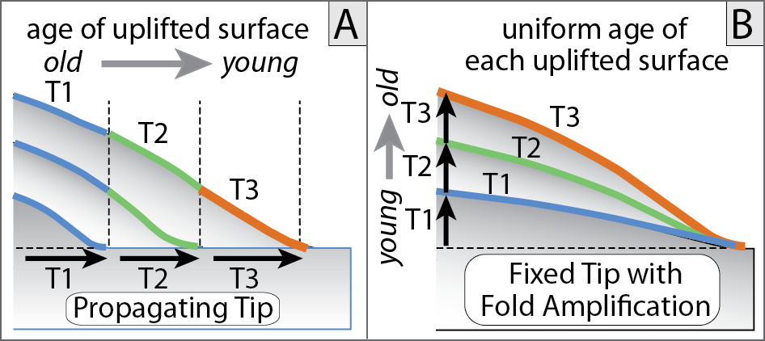
Burbank and Anderson, 2011, Tectonic Geomorphology, Chapter 9

Slide 35
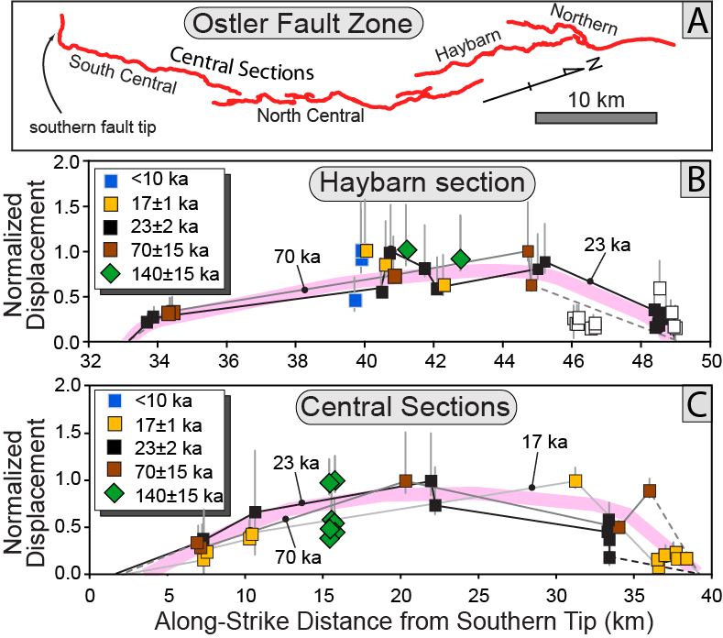
Burbank and Anderson, 2011, Tectonic Geomorphology, Chapter 9

Slide 36
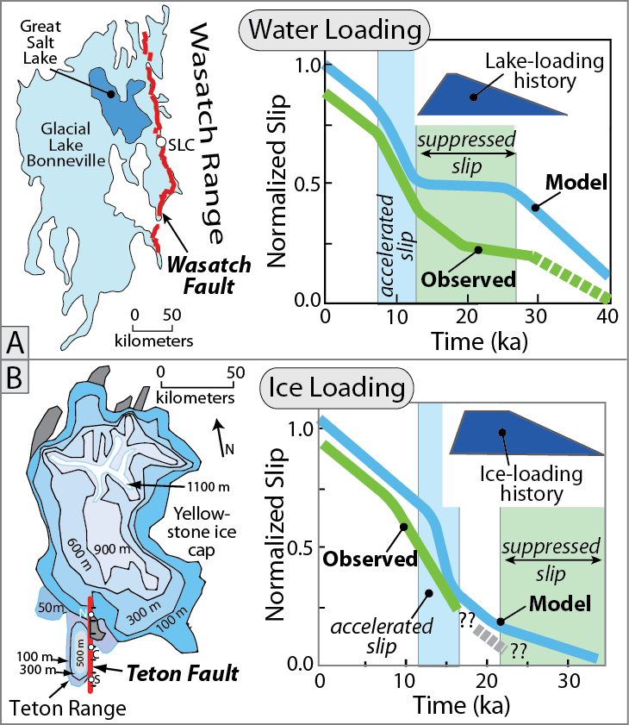
Burbank and Anderson, 2011, Tectonic Geomorphology, Chapter 9

Slide 37
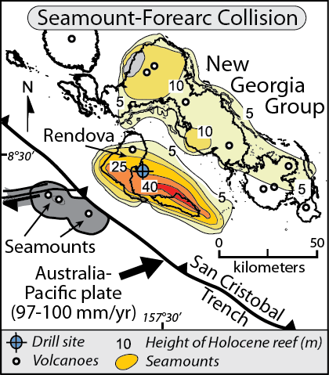
Burbank and Anderson, 2011, Tectonic Geomorphology, Chapter 9

Slide 38
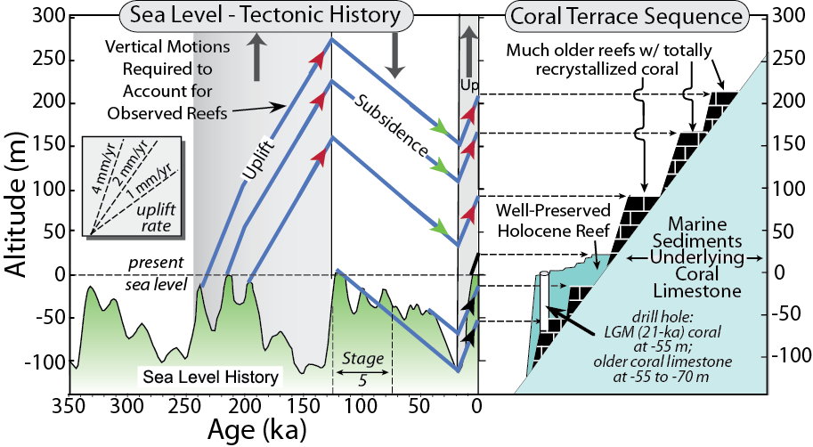
Burbank and Anderson, 2011, Tectonic Geomorphology, Chapter 9

Slide 39
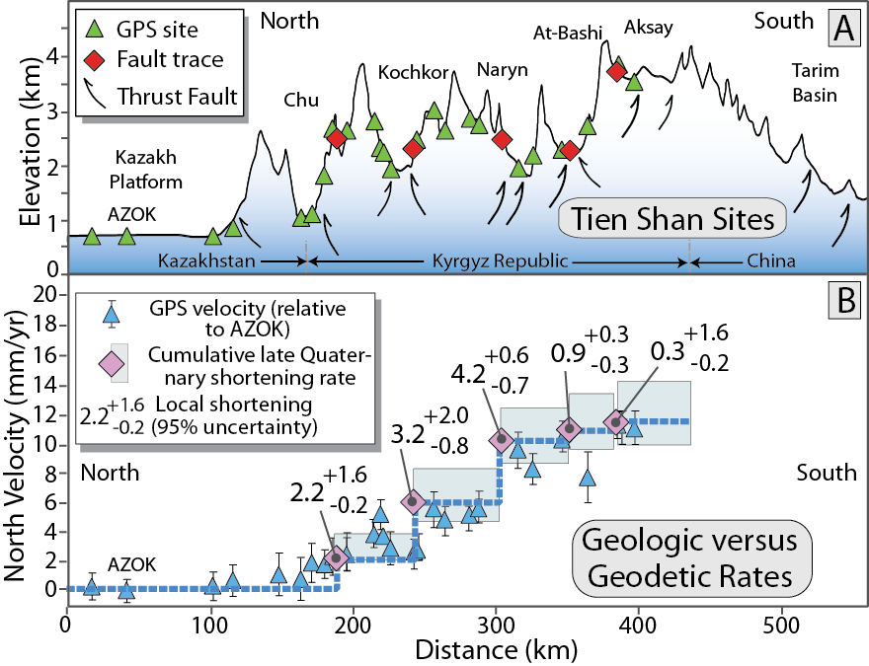
Burbank and Anderson, 2011, Tectonic Geomorphology, Chapter 9

Slide 40
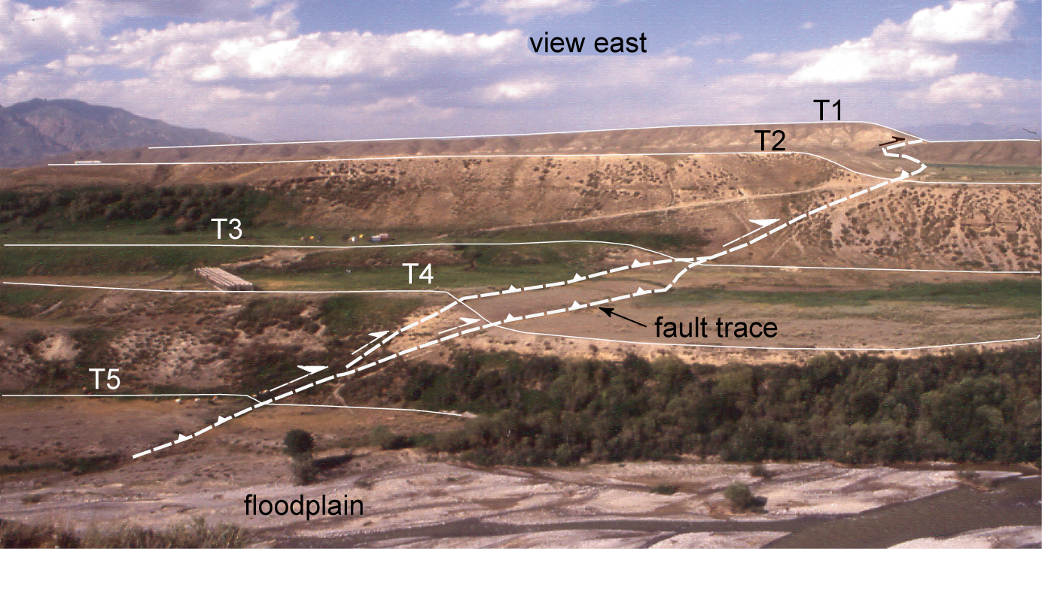
Burbank and Anderson, 2011, Tectonic Geomorphology, Chapter 9

Slide 41
Burbank and Anderson, 2011, Tectonic Geomorphology, Chapter 9

Slide 42
Burbank and Anderson, 2011, Tectonic Geomorphology, Chapter 9

